Slide 1

Stocks Price prediction with twitter sentiment analysis BY Awodaisi Adeyanju SID: 10029592
August 2021

Slide 2
Outlines
Introduction
Introduction
Research Aims and Objectives
Work done in this research
Justification for twitter preference over other social media
Related Modules
Review of related works
Methodology
Dataset collection and cleaning
Data Cleaning and preparation
Explanatory Analysis
Analysis of the pre-processed Datasets
Result Discussion
Conclusion and Recommendation
Legal/Ethic relating to the research.
Project management Dashboard

Slide 3
Introduction
Prediction of stock market prices in the past using only historical price data have shown to be inadequate due to unsatisfactory accuracy level of the results. This shows that external factors other than historical data contribute to the prices’ movement of stocks. Sentiments that are expressed daily by social medial users may contain some factors that could be analyzed and utilized to increase the accuracy of stock market price movement prediction.

Slide 4
Introduction - Research Aims and Objectives
Research Question
What is the effectiveness of Using Twitter Sentiment analysis for prediction of Stock price movement when compared with LSTM network algorithm?
Aim
To develop and suggest a more robust and reliable algorithm for stock market price movement predictions.

Slide 5
Introduction - Research Aims and Objectives
Objectives- To analyze and compare the results of predictions of stock market prices movements using sentiment analysis and LSTM networks.
To achieve the objectives the under listed steps were followed:
I extracted raw sentiments from twitter about the HSBC and IAG stocks, performed sentiment analysis of the extracted tweets. We examined the correlation between the sentiments and the price movement of the stocks within the period covered.
I extracted historical price data from yahoo finance for the selected stocks above within the same period, I used LSTM network to predict the next day price based on the extracted historic price data.
And finally, I compared the results of the two steps above for model assessment and effectiveness.

Slide 6
Introduction - Work done in this research
In this research, I used Snscrape library in python to collect tweets that contain sentiments about HSBC and IAG (using British airways tweets). The sentiments from the tweets extracted were processed further and used to predict the stock prices for the two listed companies.
Furthermore, the effectiveness of this method was compared with the results of prediction using LSTM (Long short-term memory) model for the same prediction.
The LSTM prediction model because it is presently considered as the most effective for stock price prediction using historical price data.

Slide 7
Introduction - Twitter preference over other social media
I opted for twitter over other social media because of the following reasons
Statista listed twitter among top 10 social media platform used by residents of United Kingdom.
Research mentioned that twitter cut across all ages, and it is ranked highest in terms of the percentage of educated followers among other social media [4].

Slide 8
Introduction - Related Modules
This project afforded me the opportunity to put to test experience gained in the following modules
Information retrieval
modelling,
And artificial neural networks modules.

Slide 9
Review of related works
Kalyani Joshi and Prof. Bharathi: in 2017 extracted and analyzed news sentiments of financial articles from google, reuters and yahoo finance about apple stock. Though, they were able to achieve more than 50% accuracy in their prediction, my review of the research showed limitations in the following areas
Limitations
The sentiments analyzed were limited to financial related sentiments – The research made use of financial sentiment dictionary for its polarity classification.
Using only financial articles for sentiments analysis limits the sentiments to historical data and financial performance of the referenced stocks. Other external factors such as non-financial perception about the company may not be considered in the sentiment classification. – The comments around these articles are also embed in tweets sentiments

Slide 10
Review of related works
Sidra Mehtab & Jaydip Sen (April 2020) and Qiu J, Wang B, Zhou C (2020): worked on the prediction of stock prices using historical prices data. Both made use of LSTM algorithms for the predictions. Sidra Mehtab & Jaydip Sen focused on every five minutes performance of stock price instead of usual dependance on daily close price for their prediction. Qiu J & co worked on the LSTM architecture for the prediction.
Limitation:
Prediction of stocks price with only historical price data may not provide accurate prediction as other factors beyond the financial data also affect movement of stocks.

Slide 11
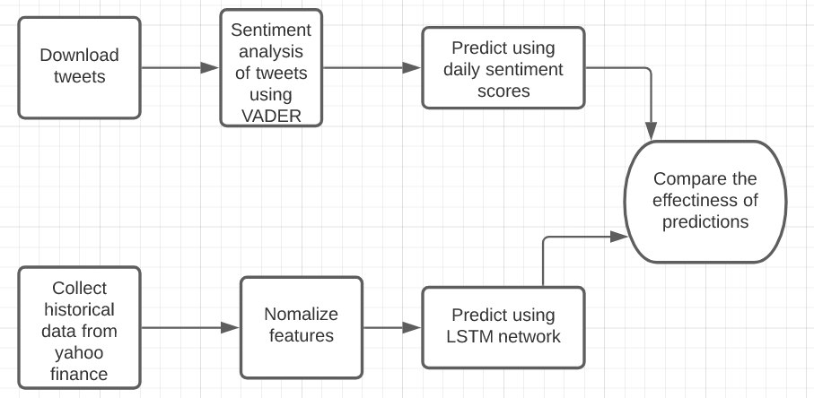
Methodology - The summarizes Diagram for methodology Steps.

Slide 12
Methodology - Dataset collection and cleaning
I made use of two datasets – tweets and historical prices data for the HSBC and IAG.
Tweets download
I made use of snscrape python library to extract all tweets in which HSBC and British Airways were mentioned between January and June 2021. BA was used for IAG because there were little tweets about IAG, anything sentiment about BA affects IAG directly. Also, there was another company named IAG that is into agriculture in the USA that may increase noise in our data. We downloaded 219,872 and 154,391 tweets respectively for HSBC and BA-IAG
The historical price data
I scraped from yahoo finance (fyahoo) with the help of free fyahoo API. Because HSBC and IAG are also listed in other markets (Hong Kong, Madrid, and New York), we used HSBC Ticker (HABS.L) for London stock exchange for the download.

Slide 13
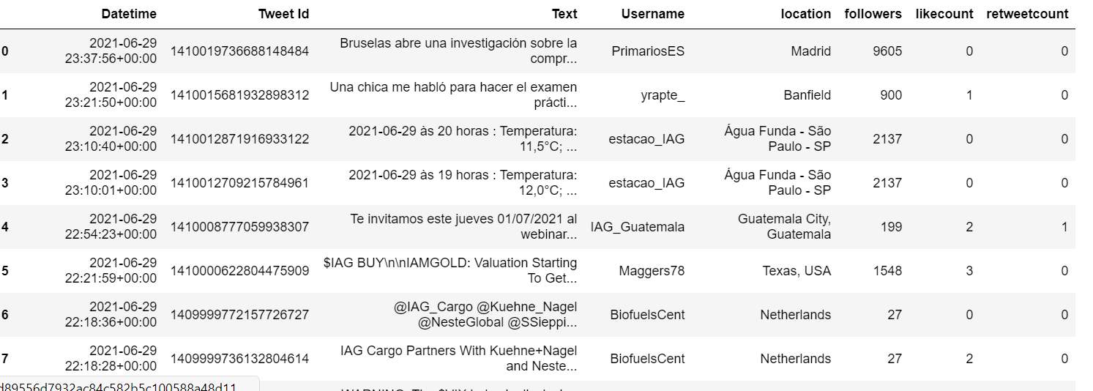
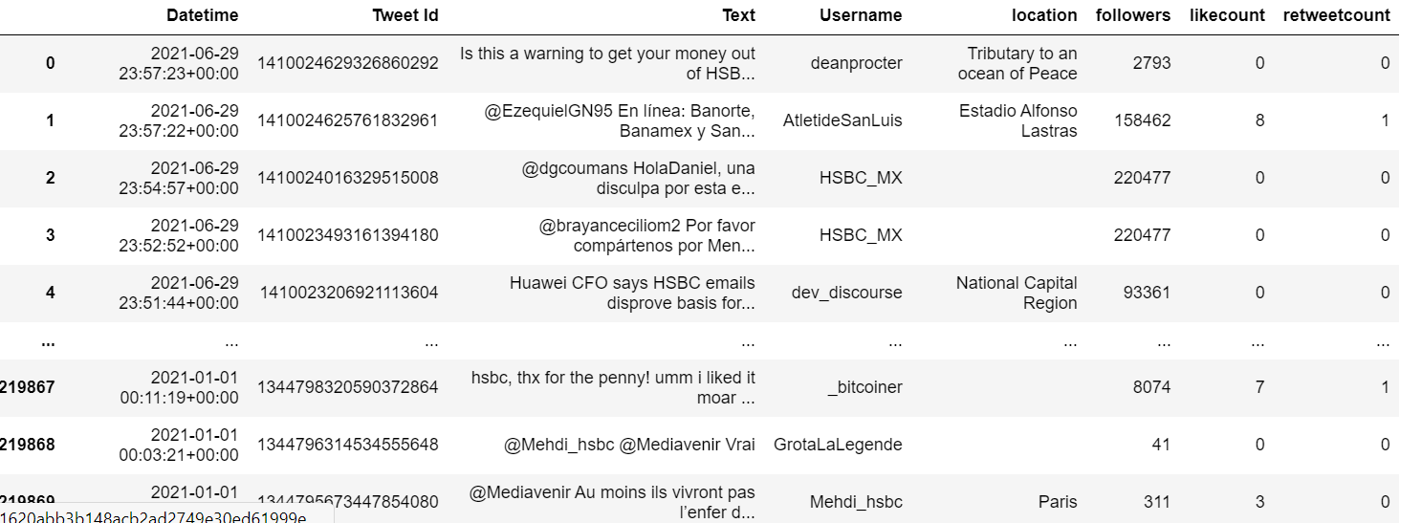
Methodology - Dataset collected

Slide 14
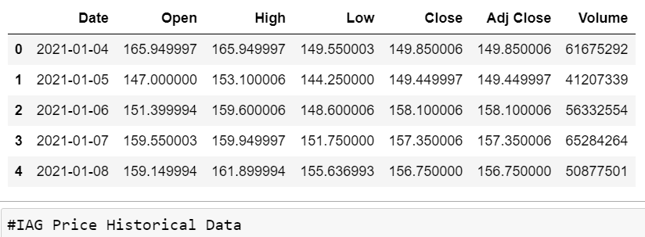
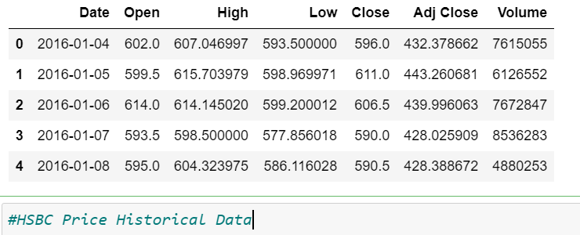
Methodology - Dataset collected

Slide 15
Methodology - Data Cleaning and preparation
To prepare the dataset for the analysis and predictions, the following were done on the dataset.
Determining and Removal of non-influential tweets- filtered out tweets from UserID with less than 1000 followers and those tweets that did not have at least 1 like.
Tokenisation of tweets
Removal of non-english tweets
Twitter Symbols Removal (“#”, “@” or htts)
Stopwords
We used the natural Language ToolKit library in python (NLTL) for the above exercises. Except for the removal of non-influential tweets. The extracted dataset for historical price data are cleaned.

Slide 16
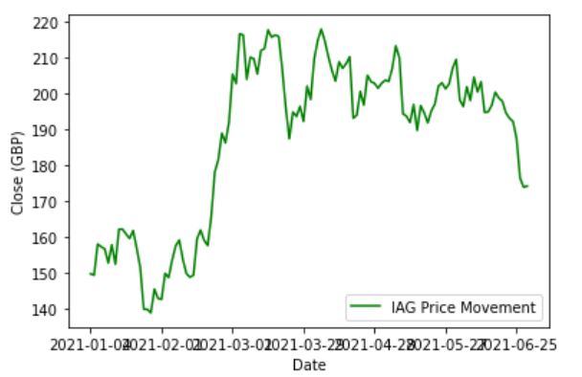
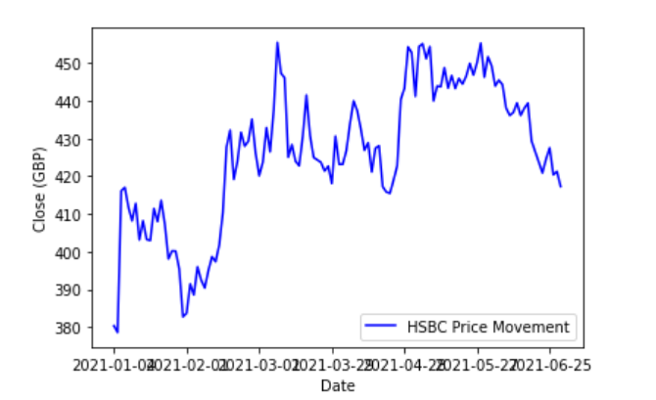
Methodology - Explanatory Analysis
Time series plots for the historical data: The plots of the price's movements for HSBC and IAG shows similar properties
The plots of the prices movements for HSBC and IAG shows similar properties, The prices of both stocks picked late January and went down again in February. The two stock reached their peaks in March 2021 before they went down again in June.

Slide 17
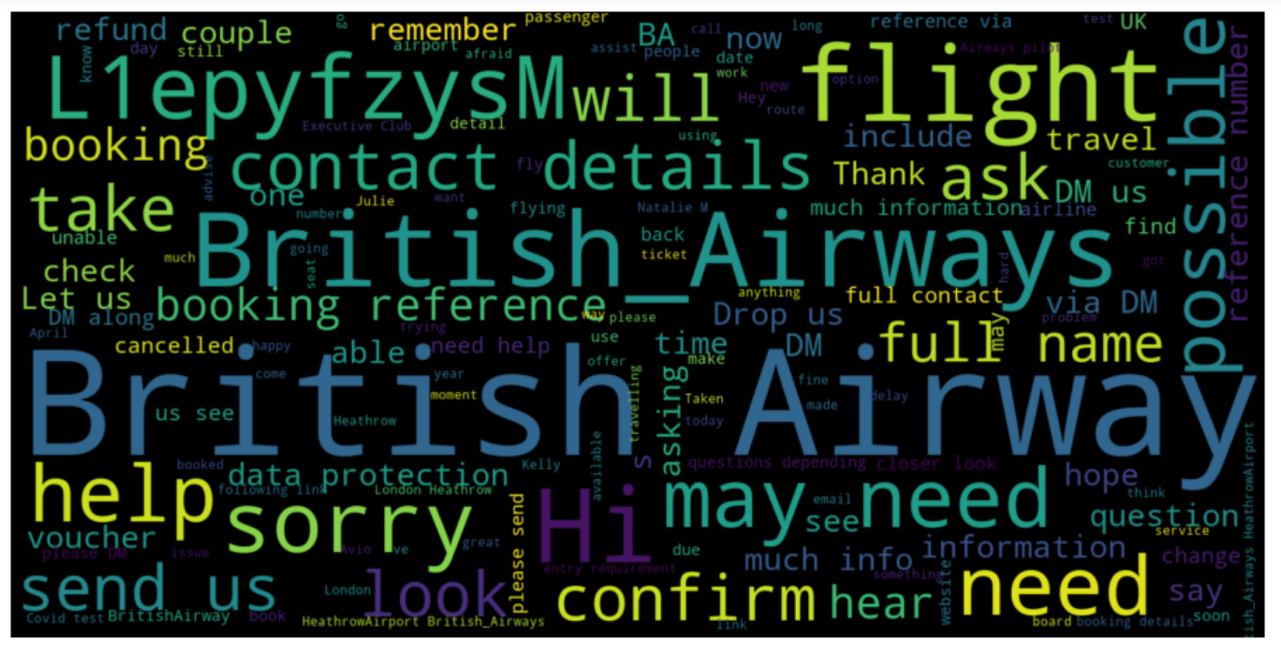
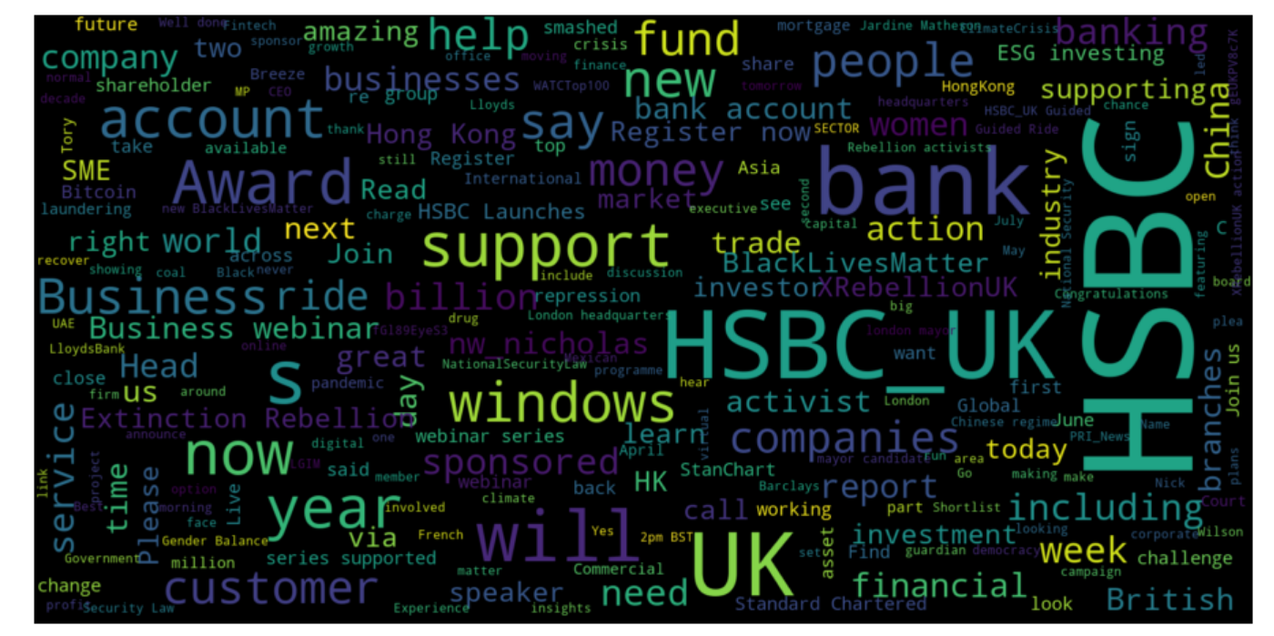
Methodology - Explanatory Analysis
Wordclouds plot of the tweets: Some of the words in the tweets text that contributed to the polarity cores used for the prediction are shown below. For example, amazing, help, supporting, awards, great, and available were positive words that came through for HSBC. Negative words such as Extinction, rebellion, laundering could be seen as well. See figure below .

Slide 18
Methodology - Analysis of the pre-processed Datasets
Sentiment analysis of the tweet’s dataset: To get the polarity for each day between 1 January and 30 June 2021, I did sentiment analysis of each of the tweet’s data for the stocks. I used VADER for the sentiment analysis of the tweets. VADER is a pretrained model in python that can classify or label social media lexicons into different polarity based on their semantic orientations. It allots polarity scores to each tweet based on their polarity depth.
Positive sentiment: (compound score >= 0.05) Neutral sentiment: (compound score > -0.05) and (compound score < 0.05) Negative sentiment: (compound score <= -0.05).
The score is allocated to show how negative, positive, or neutral a text/tweet is.
Finally, VADER will calculate the average (compound) of the polarity score for each of the tweets.

Slide 19
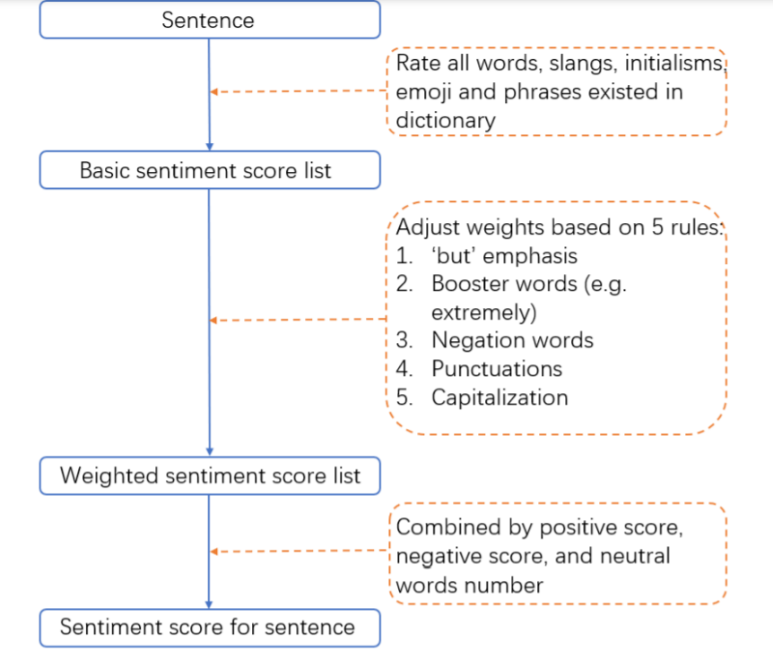
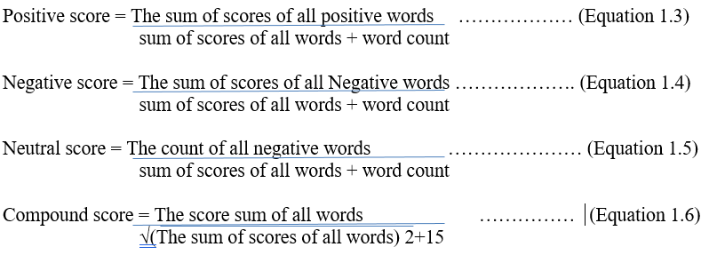
Methodology - Analysis of the pre-processed Datasets
VADER sentiment package process Steps
Formular for the sentiment scores allocation for each sentence according to Heng Gui, (2019)

Slide 20
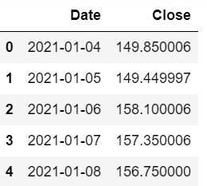
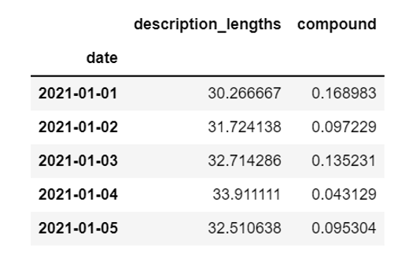
Methodology - Computation of compound score:
Datetime conversion and daily Computation of compound score:
To have a similar dataframe that is similar to historical price data, we computed the daily average of the tweet sentiments compound polarity by using groupby function on python. See the result

Slide 21
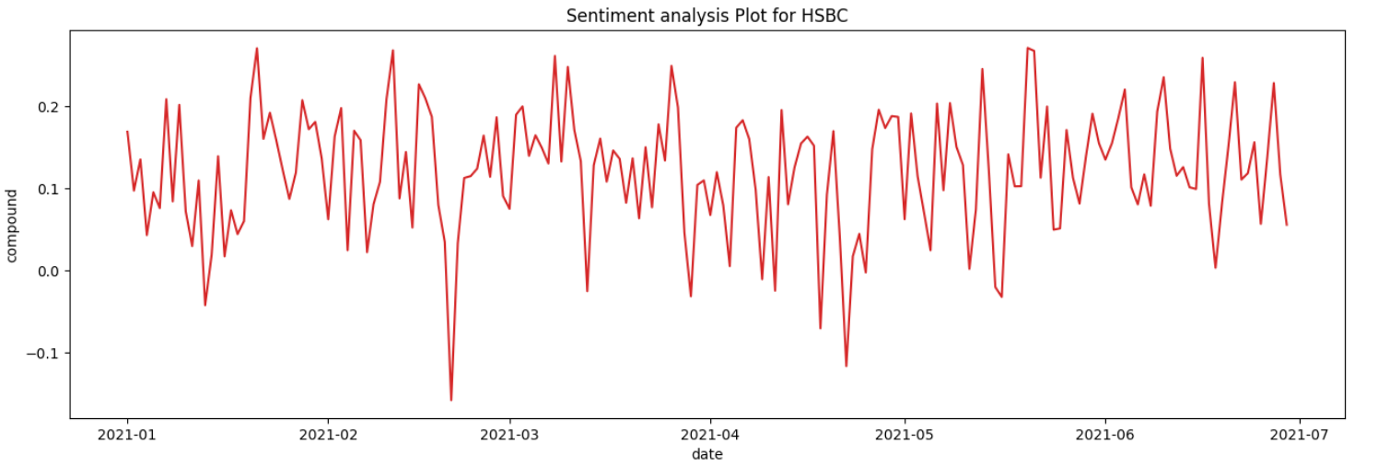
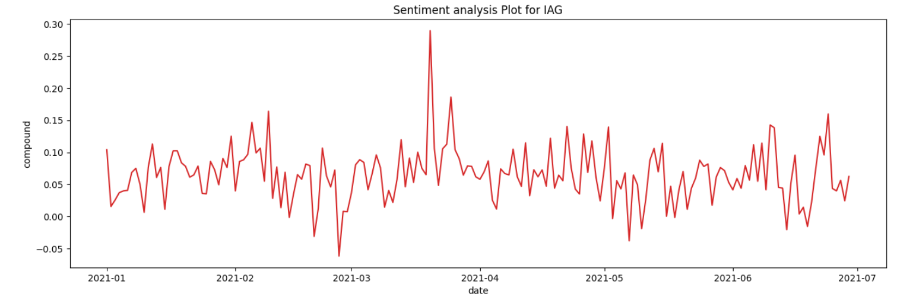
Methodology - Analysis of the pre-processed Datasets
Sentiment polarity plot for HSBC and IAG between January and June 2021.

Slide 22
Methodology - Analysis of the pre-processed Datasets
Training of LSTM Model:
The historical price data was split into training (80%) and testing (20%) for each of HSBC and IAG. I normalized the training data to make them trainable in LSTM. I defined the datasets shapes; the number of units and the dropout rate were defined. The dropout rate is defined to prevent overfitting, the output layers is specified to have a linear activation function. In addition, For the purpose of training, we used historical dataset between 1 January 2017 and June 2021.
After the training of the models. I used both twitter Sentiment analysis and LSTM models to predict the price movements for the stocks of the two companies.

Slide 23
Result Discussion
When both LSTM network and Sentiment analysis were use for the predictions of the next day (1 July 2021 - 1135th day) stock price movements for both IAG and HSBC. The results showed that the predictions were correct using outcomes of sentiment analysis. The sentiment analysis predictions indicated positive prices movements for the stocks. However, prediction using LSTM model showed a positive price movement for HSBC and negative for IAG.
It is also worthy of note that, although LSTM model prediction for IAG was negative as against the actual price which was positive , the prediction accuracy in terms of closeness to the actual price was 92.5%.

Slide 24
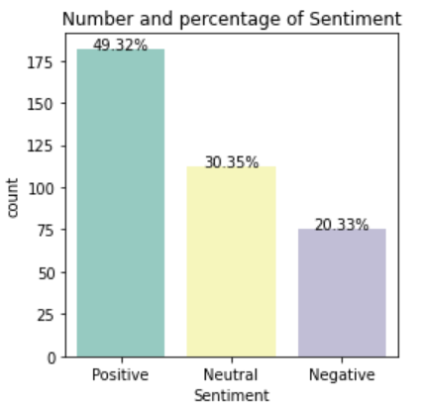
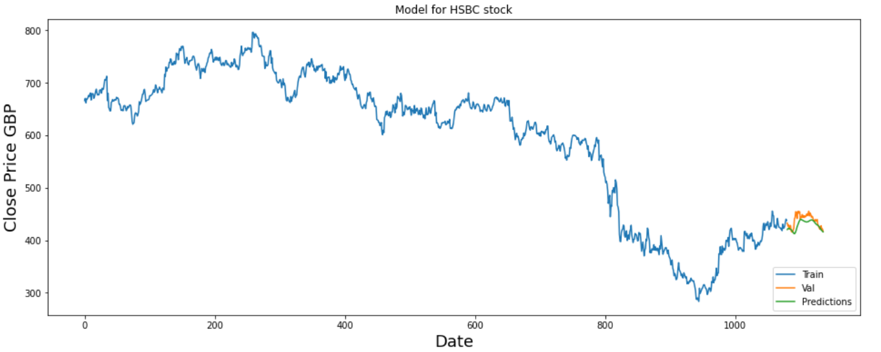
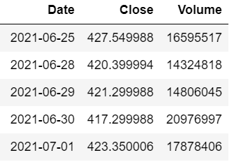
Result Discussion

Slide 25
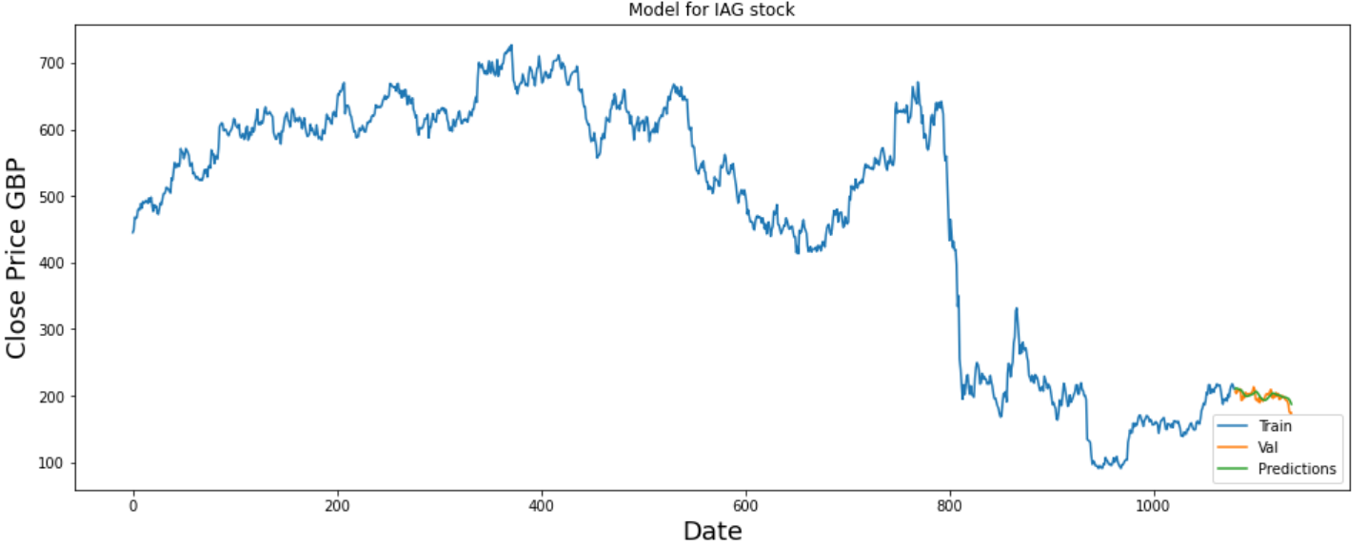
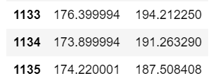
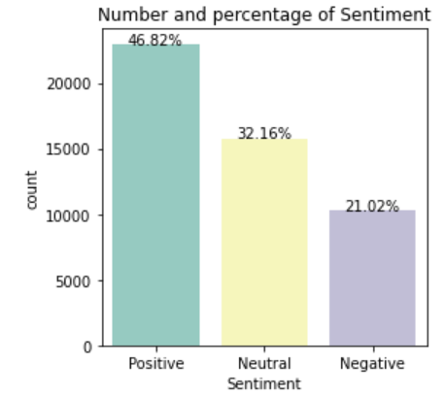
Result Discussion – Continued IAG Prediction results

Slide 26
Conclusion and Suggestion
I deduced from the results of the research that both methods could be employment for the predictions of stock prices movement.
If properly analyzed, outcomes of sentiment analysis for the prediction may be good for classification prediction of stock price. The investors could know if stock price will move up or down.
LSTM in another hand, will help for prediction of approximate amount in which a stock should be purchased.
Further Work
Further work on combining the two methods in a system for price prediction will be a good research for scholars.

Slide 27
Legal/Ethic relating to the research.
There was no legal issue related to the project.
To avoid ethic violation in the project, I removed the Usernames and IDs of the twitter users. I did this to avoid the linking of any of the tweets to any individual or group.

Slide 28
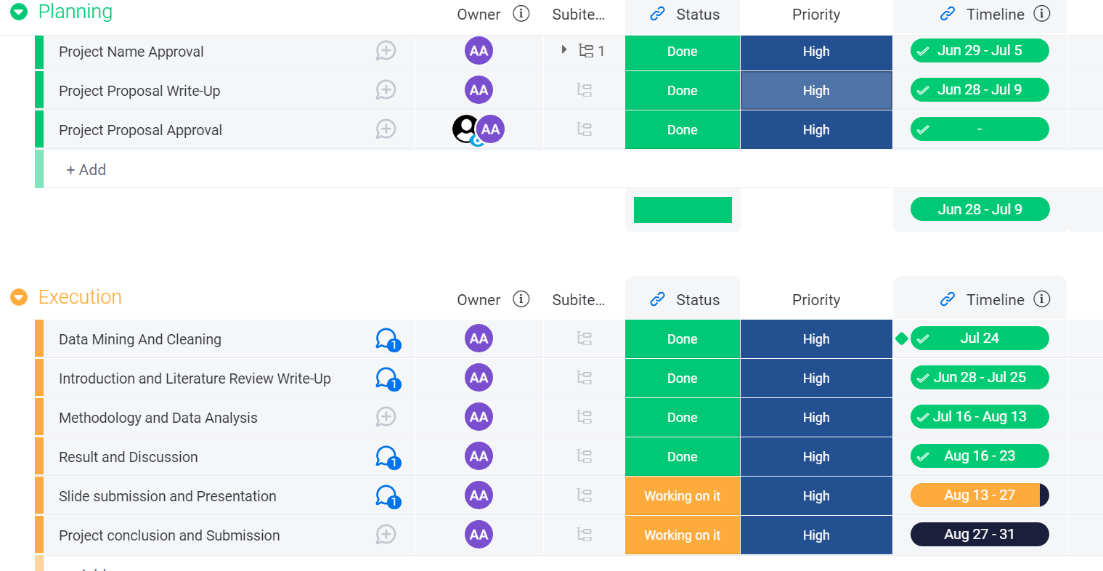
Project Management Dashboard

Slide 29
Reference
[1] Anshul Mittal and Arpit Goel (2014). Stock Prediction Using Twitter Sentiment Analysis http://cs229.stanford.edu/proj2011/GoelMittal-StockMarketPredictionUsingTwitterSentimentAnalysis.pdf. Accessed 31 July 2021
[2] Kalyani Joshi1 and Prof. Bharathi, (2017). Stock Trend Prediction using News sentiment analysis. A paper submitted to European Journal of Molecular & Clinical Medicine (5060 – 5069),Volume 07, Issue 02, 2020.
[3] Michael Phi, (September 2018). Illustrated Guide to LSTM’s and GRU’s: A step by step explanation. https://towardsdatascience.com/illustrated-guide-to-lstms-and-gru-s-a-step-by-step-explanation-44e9eb85bf21. Accessed 30 June 2021.
[4] statistical, (Oct 2020). Internet usage worldwide. https://www.statista.com/topics/1145/internet-usage-worldwide/#:~:text=In%202019%2C%20the%20number%20of,currently%20connected%20to%20the%20internet. Accessed 29 June 2021.

Slide 30
THANK YOU

